Slide 1
Merging Dataset: KNHANES
Jongmin Kim <jmkim@pukyong.ac.kr>
1/29/2020

Slide 2
KNHANES Dataset
2~9개 파일로 분할 배포
기본DB (HNYY_ALL)
HNYY_DSRAW: 건강 설문
HNYY_IJMT: 손상 및 의료 이용
HNYY_PAM: 가속도계 조사
HNYY_OE: 구강 검사
HNYY_DXA: 골밀도 및 체지방 검사
HNYY_EYE: 안검사
HNYY_ENT: 이비인후검사
HNYY_FFQ: 식품섭취빈도조사
HNYY_24RC: 식품섭취조사(24시 회상 조사)
Divided into 2~9 files (different every year; YY: year)
기본DB (HNYY_ALL): Base database
HNYY_DSRAW: Health survey
HNYY_IJMT: Body injury and Medical center use
HNYY_PAM: Actigraph survey
HNYY_OE: Oral Examination
HNYY_DXA: Bone density and Body fat examination
HNYY_EYE: Eye examination
HNYY_ENT: ENT examination
HNYY_FFQ: Food intake frequency survey
HNYY_24RC: Food intake survey (24 hours recollection)

Slide 3
자료의 개수 | 제1기 | 제2기 | 제3기 | 제4기 |  |  | 제5기 |  |  | 제6기 |  |  | 제7기
(변수의 개수) | (1998) | (2001) | (2005) | (2007) | (2008) | (2009) | (2010) | (2011) | (2012) | (2013) | (2014) | (2015) | (2016) | (2017) | (2018)
▪건강설문조사
가구조사 | 39,060 | 37,769 | 34,145 | 4,594 | 9,744 | 10,533 | 8,958 | 8,518 | 8,058 | 8,018 | 7,550 | 7,380 | 8,150 | 8,127 | 7,992
(HNYR_ALL) | (47) | (47) | (57) | (49) | (60) | (62) | (40) | (48) | (40) | (56) | (41) | (43) | (41) | (49) | (43)
건강면접조사 | 39,060 | 37,769 | 34,145 | 4,148 | 9,281 | 10,051 | 8,388 | 7,895 | 7,337 | 7,277 | 6,888 | 6,904 | 7,797 | 7,700 | 7,642
(HNYR_ALL) | (78) | (816) | (355) | (771) | (771) | (774) | (449) | (441) | (429) | (330) | (369) | (411) | (461) | (506) | (448)
건강행태조사 | 10,808 | 9,170 | 23,000
(HNYR_ALL) | (111) | (146) | (162)
손상및의료이용 | 39,060 | 37,769 | 34,145 | 4,148 | 9,281 | 10,051 | 8,388 | 7,895 | 7,337 | 7,277 | 6,888 | 6,904 | - | - | -
(HNYR_IJMT) | (216) | (548) | (1,510) | (830) | (1,233) | (874) | (609) | (697) | (425) | (256) | (324) | (248)
이환카드 | 39,060 | 37,769 | - | - | - | - | - | - | - | - | - | - | - | - | -
(HNYR_DSRAW) | (350) | (414)
▪검진조사
검진조사 | 9,771 | 9,702 | 7,597 | 4,246 | 9,307 | 10,078 | 8,473 | 8,055 | 7,713 | 7,571 | 7,167 | 6,976 | 7,803 | 7,707 | 7,689
(HNYR_ALL) | (70) | (68) | (130) | (74) | (109) | (137) | (185) | (172) | (169) | (243) | (213) | (211) | (194) | (192) | (163)
구강검사 | - | - | - | 4,246 | 9,307 | 10,078 | 8,473 | 7,836 | 7,353 | 7,507 | 7,167 | 6,977 | 16,489
(HNYR_OE) |  |  |  | (335) | (346) | (348) | (315) | (308) | (314) | (314) | (314) | (314) | (315)
안검사 | - | - | - | - | 4,846 | 9,760 | 8,141 | 7,791 | 7,444 | - | - | - | - | - | -
(HNYR_EYE) |  |  |  |  | (212) | (217) | (209) | (216) | (163)
이비인후검사 | - | - | - | - | 4,592 | 10,065 | 8,313 | 7,887 | 7,421 | - | - | - | - | - | -
(HNYR_ENT) |  |  |  |  | (132) | (152) | (142) | (123) | (104)
골밀도검사 | - | - | - | - | 3,583 | 7,920 | 7,043 | 2,757 | - | - | - | - | - | - | -
(HNYR_DXA) |  |  |  |  | (156) | (159) | (140) | (114)
▪영양조사
영양조사 | 11,267 | 10,000 | 9,004 | 4,099 | 8,641 | 9,397 | 8,027 | 7,715 | 7,024 | 7,242 | 6,803 | 6,630 | 7,049 | 7,169 | 7,069
(HNYR_ALL) | (99) | (122) | (176) | (205) | (208) | (211) | (132) | (132) | (92) | (96) | (96) | (96) | (76) | (76) | (76)
식품섭취조사 | 454,841 | 430,890 | 420,794 | 197 | 418,628 | 462,127 | 476,964 | 451,014 | 415,443 | 472,354 | 446,753 | 447,718 | 548,239 | 529,444 | 509,819
(HNYR_24RC) | (36) | (42) | (45) | (48) | (51) | (51) | (72) | (72) | (55) | (85) | (85) | (100) | (99) | (99) | (84)
식품섭취빈도조사 | - | - | - | - | - | - | - | - | 3,984 | 4,152 | 3,810 | 3,302 | 3,371 | - | -
(HNYR_FFQ) |  |  |  |  |  |  |  |  | (401) | (402) | (402) | (402) | (402) | - | -
식이보충제조사 | - | - | - | - | - | - | - | - | - | - | - | - | - | - | 3,247
(HNYR_SUP) |  |  |  |  |  |  |  |  |  |  |  |  |  |  | (80)

Slide 4
자료의 개수 | 제1기 | 제2기 | 제3기 | 제4기 |  |  | 제5기 |  |  | 제6기 |  |  | 제7기
(변수의 개수) | (1998) | (2001) | (2005) | (2007) | (2008) | (2009) | (2010) | (2011) | (2012) | (2013) | (2014) | (2015) | (2016) | (2017) | (2018)
▪건강설문조사
가구조사 | 39,060 | 37,769 | 34,145 | 4,594 | 9,744 | 10,533 | 8,958 | 8,518 | 8,058 | 8,018 | 7,550 | 7,380 | 8,150 | 8,127 | 7,992
(HNYR_ALL) | (47) | (47) | (57) | (49) | (60) | (62) | (40) | (48) | (40) | (56) | (41) | (43) | (41) | (49) | (43)
건강면접조사 | 39,060 | 37,769 | 34,145 | 4,148 | 9,281 | 10,051 | 8,388 | 7,895 | 7,337 | 7,277 | 6,888 | 6,904 | 7,797 | 7,700 | 7,642
(HNYR_ALL) | (78) | (816) | (355) | (771) | (771) | (774) | (449) | (441) | (429) | (330) | (369) | (411) | (461) | (506) | (448)
건강행태조사 | 10,808 | 9,170 | 23,000
(HNYR_ALL) | (111) | (146) | (162)
손상및의료이용 | 39,060 | 37,769 | 34,145 | 4,148 | 9,281 | 10,051 | 8,388 | 7,895 | 7,337 | 7,277 | 6,888 | 6,904 | - | - | -
(HNYR_IJMT) | (216) | (548) | (1,510) | (830) | (1,233) | (874) | (609) | (697) | (425) | (256) | (324) | (248)
이환카드 | 39,060 | 37,769 | - | - | - | - | - | - | - | - | - | - | - | - | -
(HNYR_DSRAW) | (350) | (414)
▪검진조사
검진조사 | 9,771 | 9,702 | 7,597 | 4,246 | 9,307 | 10,078 | 8,473 | 8,055 | 7,713 | 7,571 | 7,167 | 6,976 | 7,803 | 7,707 | 7,689
(HNYR_ALL) | (70) | (68) | (130) | (74) | (109) | (137) | (185) | (172) | (169) | (243) | (213) | (211) | (194) | (192) | (163)
구강검사 | - | - | - | 4,246 | 9,307 | 10,078 | 8,473 | 7,836 | 7,353 | 7,507 | 7,167 | 6,977 | 16,489
(HNYR_OE) |  |  |  | (335) | (346) | (348) | (315) | (308) | (314) | (314) | (314) | (314) | (315)
안검사 | - | - | - | - | 4,846 | 9,760 | 8,141 | 7,791 | 7,444 | - | - | - | - | - | -
(HNYR_EYE) |  |  |  |  | (212) | (217) | (209) | (216) | (163)
이비인후검사 | - | - | - | - | 4,592 | 10,065 | 8,313 | 7,887 | 7,421 | - | - | - | - | - | -
(HNYR_ENT) |  |  |  |  | (132) | (152) | (142) | (123) | (104)
골밀도검사 | - | - | - | - | 3,583 | 7,920 | 7,043 | 2,757 | - | - | - | - | - | - | -
(HNYR_DXA) |  |  |  |  | (156) | (159) | (140) | (114)
▪영양조사
영양조사 | 11,267 | 10,000 | 9,004 | 4,099 | 8,641 | 9,397 | 8,027 | 7,715 | 7,024 | 7,242 | 6,803 | 6,630 | 7,049 | 7,169 | 7,069
(HNYR_ALL) | (99) | (122) | (176) | (205) | (208) | (211) | (132) | (132) | (92) | (96) | (96) | (96) | (76) | (76) | (76)
식품섭취조사 | 454,841 | 430,890 | 420,794 | 197 | 418,628 | 462,127 | 476,964 | 451,014 | 415,443 | 472,354 | 446,753 | 447,718 | 548,239 | 529,444 | 509,819
(HNYR_24RC) | (36) | (42) | (45) | (48) | (51) | (51) | (72) | (72) | (55) | (85) | (85) | (100) | (99) | (99) | (84)
식품섭취빈도조사 | - | - | - | - | - | - | - | - | 3,984 | 4,152 | 3,810 | 3,302 | 3,371 | - | -
(HNYR_FFQ) |  |  |  |  |  |  |  |  | (401) | (402) | (402) | (402) | (402) | - | -
식이보충제조사 | - | - | - | - | - | - | - | - | - | - | - | - | - | - | 3,247
(HNYR_SUP) |  |  |  |  |  |  |  |  |  |  |  |  |  |  | (80)
All DB
Number of IDs == Number of cases
All DB
24RC
24RC

Slide 5
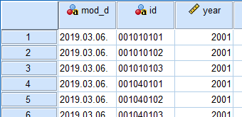
SPSS data merging
Variable merging
Merge the divided same year data
ALL + IJMT + DSRAW + OE
Column = Variable
Case merging
Merge the different year data
1998 + 2001 + 2005
Row = Case
Variable merging
→ → →
Column = Variable
Row = Case
Case merging
→ →

Slide 6
자료의 개수 | 제1기 | 제2기 | 제3기 | 제4기 |  |  | 제5기 |  |  | 제6기 |  |  | 제7기
(변수의 개수) | (1998) | (2001) | (2005) | (2007) | (2008) | (2009) | (2010) | (2011) | (2012) | (2013) | (2014) | (2015) | (2016) | (2017) | (2018)
▪건강설문조사
가구조사 | 39,060 | 37,769 | 34,145 | 4,594 | 9,744 | 10,533 | 8,958 | 8,518 | 8,058 | 8,018 | 7,550 | 7,380 | 8,150 | 8,127 | 7,992
(HNYR_ALL) | (47) | (47) | (57) | (49) | (60) | (62) | (40) | (48) | (40) | (56) | (41) | (43) | (41) | (49) | (43)
건강면접조사 | 39,060 | 37,769 | 34,145 | 4,148 | 9,281 | 10,051 | 8,388 | 7,895 | 7,337 | 7,277 | 6,888 | 6,904 | 7,797 | 7,700 | 7,642
(HNYR_ALL) | (78) | (816) | (355) | (771) | (771) | (774) | (449) | (441) | (429) | (330) | (369) | (411) | (461) | (506) | (448)
건강행태조사 | 10,808 | 9,170 | 23,000
(HNYR_ALL) | (111) | (146) | (162)
손상및의료이용 | 39,060 | 37,769 | 34,145 | 4,148 | 9,281 | 10,051 | 8,388 | 7,895 | 7,337 | 7,277 | 6,888 | 6,904 | - | - | -
(HNYR_IJMT) | (216) | (548) | (1,510) | (830) | (1,233) | (874) | (609) | (697) | (425) | (256) | (324) | (248)
이환카드 | 39,060 | 37,769 | - | - | - | - | - | - | - | - | - | - | - | - | -
(HNYR_DSRAW) | (350) | (414)
▪검진조사
검진조사 | 9,771 | 9,702 | 7,597 | 4,246 | 9,307 | 10,078 | 8,473 | 8,055 | 7,713 | 7,571 | 7,167 | 6,976 | 7,803 | 7,707 | 7,689
(HNYR_ALL) | (70) | (68) | (130) | (74) | (109) | (137) | (185) | (172) | (169) | (243) | (213) | (211) | (194) | (192) | (163)
구강검사 | - | - | - | 4,246 | 9,307 | 10,078 | 8,473 | 7,836 | 7,353 | 7,507 | 7,167 | 6,977 | 16,489
(HNYR_OE) |  |  |  | (335) | (346) | (348) | (315) | (308) | (314) | (314) | (314) | (314) | (315)
안검사 | - | - | - | - | 4,846 | 9,760 | 8,141 | 7,791 | 7,444 | - | - | - | - | - | -
(HNYR_EYE) |  |  |  |  | (212) | (217) | (209) | (216) | (163)
이비인후검사 | - | - | - | - | 4,592 | 10,065 | 8,313 | 7,887 | 7,421 | - | - | - | - | - | -
(HNYR_ENT) |  |  |  |  | (132) | (152) | (142) | (123) | (104)
골밀도검사 | - | - | - | - | 3,583 | 7,920 | 7,043 | 2,757 | - | - | - | - | - | - | -
(HNYR_DXA) |  |  |  |  | (156) | (159) | (140) | (114)
▪영양조사
영양조사 | 11,267 | 10,000 | 9,004 | 4,099 | 8,641 | 9,397 | 8,027 | 7,715 | 7,024 | 7,242 | 6,803 | 6,630 | 7,049 | 7,169 | 7,069
(HNYR_ALL) | (99) | (122) | (176) | (205) | (208) | (211) | (132) | (132) | (92) | (96) | (96) | (96) | (76) | (76) | (76)
식품섭취조사 | 454,841 | 430,890 | 420,794 | 197 | 418,628 | 462,127 | 476,964 | 451,014 | 415,443 | 472,354 | 446,753 | 447,718 | 548,239 | 529,444 | 509,819
(HNYR_24RC) | (36) | (42) | (45) | (48) | (51) | (51) | (72) | (72) | (55) | (85) | (85) | (100) | (99) | (99) | (84)
식품섭취빈도조사 | - | - | - | - | - | - | - | - | 3,984 | 4,152 | 3,810 | 3,302 | 3,371 | - | -
(HNYR_FFQ) |  |  |  |  |  |  |  |  | (401) | (402) | (402) | (402) | (402) | - | -
식이보충제조사 | - | - | - | - | - | - | - | - | - | - | - | - | - | - | 3,247
(HNYR_SUP) |  |  |  |  |  |  |  |  |  |  |  |  |  |  | (80)
98#1
01#1
09#1
17#1
18#1
98#2
01#2
09#2
98#3
01#3
98#1
01#1
09#1
09#3
09#4
09#5
09#6
98#1
01#1
09#1
17#2
18#2
98#4
01#4
01#8
01#9
17#3
18#3

Slide 7
자료의 개수 | 제1기 | 제2기 | 제3기 | 제4기 |  |  | 제5기 |  |  | 제6기 |  |  | 제7기
(변수의 개수) | (1998) | (2001) | (2005) | (2007) | (2008) | (2009) | (2010) | (2011) | (2012) | (2013) | (2014) | (2015) | (2016) | (2017) | (2018)
▪건강설문조사
가구조사 | 39,060 | 37,769 | 34,145 | 4,594 | 9,744 | 10,533 | 8,958 | 8,518 | 8,058 | 8,018 | 7,550 | 7,380 | 8,150 | 8,127 | 7,992
(HNYR_ALL) | (47) | (47) | (57) | (49) | (60) | (62) | (40) | (48) | (40) | (56) | (41) | (43) | (41) | (49) | (43)
건강면접조사 | 39,060 | 37,769 | 34,145 | 4,148 | 9,281 | 10,051 | 8,388 | 7,895 | 7,337 | 7,277 | 6,888 | 6,904 | 7,797 | 7,700 | 7,642
(HNYR_ALL) | (78) | (816) | (355) | (771) | (771) | (774) | (449) | (441) | (429) | (330) | (369) | (411) | (461) | (506) | (448)
건강행태조사 | 10,808 | 9,170 | 23,000
(HNYR_ALL) | (111) | (146) | (162)
손상및의료이용 | 39,060 | 37,769 | 34,145 | 4,148 | 9,281 | 10,051 | 8,388 | 7,895 | 7,337 | 7,277 | 6,888 | 6,904 | - | - | -
(HNYR_IJMT) | (216) | (548) | (1,510) | (830) | (1,233) | (874) | (609) | (697) | (425) | (256) | (324) | (248)
이환카드 | 39,060 | 37,769 | - | - | - | - | - | - | - | - | - | - | - | - | -
(HNYR_DSRAW) | (350) | (414)
▪검진조사
검진조사 | 9,771 | 9,702 | 7,597 | 4,246 | 9,307 | 10,078 | 8,473 | 8,055 | 7,713 | 7,571 | 7,167 | 6,976 | 7,803 | 7,707 | 7,689
(HNYR_ALL) | (70) | (68) | (130) | (74) | (109) | (137) | (185) | (172) | (169) | (243) | (213) | (211) | (194) | (192) | (163)
구강검사 | - | - | - | 4,246 | 9,307 | 10,078 | 8,473 | 7,836 | 7,353 | 7,507 | 7,167 | 6,977 | 16,489
(HNYR_OE) |  |  |  | (335) | (346) | (348) | (315) | (308) | (314) | (314) | (314) | (314) | (315)
안검사 | - | - | - | - | 4,846 | 9,760 | 8,141 | 7,791 | 7,444 | - | - | - | - | - | -
(HNYR_EYE) |  |  |  |  | (212) | (217) | (209) | (216) | (163)
이비인후검사 | - | - | - | - | 4,592 | 10,065 | 8,313 | 7,887 | 7,421 | - | - | - | - | - | -
(HNYR_ENT) |  |  |  |  | (132) | (152) | (142) | (123) | (104)
골밀도검사 | - | - | - | - | 3,583 | 7,920 | 7,043 | 2,757 | - | - | - | - | - | - | -
(HNYR_DXA) |  |  |  |  | (156) | (159) | (140) | (114)
▪영양조사
영양조사 | 11,267 | 10,000 | 9,004 | 4,099 | 8,641 | 9,397 | 8,027 | 7,715 | 7,024 | 7,242 | 6,803 | 6,630 | 7,049 | 7,169 | 7,069
(HNYR_ALL) | (99) | (122) | (176) | (205) | (208) | (211) | (132) | (132) | (92) | (96) | (96) | (96) | (76) | (76) | (76)
식품섭취조사 | 454,841 | 430,890 | 420,794 | 197 | 418,628 | 462,127 | 476,964 | 451,014 | 415,443 | 472,354 | 446,753 | 447,718 | 548,239 | 529,444 | 509,819
(HNYR_24RC) | (36) | (42) | (45) | (48) | (51) | (51) | (72) | (72) | (55) | (85) | (85) | (100) | (99) | (99) | (84)
식품섭취빈도조사 | - | - | - | - | - | - | - | - | 3,984 | 4,152 | 3,810 | 3,302 | 3,371 | - | -
(HNYR_FFQ) |  |  |  |  |  |  |  |  | (401) | (402) | (402) | (402) | (402) | - | -
식이보충제조사 | - | - | - | - | - | - | - | - | - | - | - | - | - | - | 3,247
(HNYR_SUP) |  |  |  |  |  |  |  |  |  |  |  |  |  |  | (80)
98#1
01#1
09#1
17#1
18#1
98#2
01#2
09#2
98#3
01#3
All DB
Number of IDs == Number of cases
98#1
01#1
09#1
09#3
09#4
09#5
All DB
24RC
09#6
98#1
01#1
09#1
17#2
18#2
98#4
01#4
24RC
17#3
18#3
01#8
01#9

Slide 8
자료의 개수 | 제1기 | 제2기 | 제3기 | 제4기 |  |  | 제5기 |  |  | 제6기 |  |  | 제7기
(변수의 개수) | (1998) | (2001) | (2005) | (2007) | (2008) | (2009) | (2010) | (2011) | (2012) | (2013) | (2014) | (2015) | (2016) | (2017) | (2018)
▪건강설문조사
가구조사 | 39,060 | 37,769 | 34,145 | 4,594 | 9,744 | 10,533 | 8,958 | 8,518 | 8,058 | 8,018 | 7,550 | 7,380 | 8,150 | 8,127 | 7,992
(HNYR_ALL) | (47) | (47) | (57) | (49) | (60) | (62) | (40) | (48) | (40) | (56) | (41) | (43) | (41) | (49) | (43)
건강면접조사 | 39,060 | 37,769 | 34,145 | 4,148 | 9,281 | 10,051 | 8,388 | 7,895 | 7,337 | 7,277 | 6,888 | 6,904 | 7,797 | 7,700 | 7,642
(HNYR_ALL) | (78) | (816) | (355) | (771) | (771) | (774) | (449) | (441) | (429) | (330) | (369) | (411) | (461) | (506) | (448)
건강행태조사 | 10,808 | 9,170 | 23,000
(HNYR_ALL) | (111) | (146) | (162)
손상및의료이용 | 39,060 | 37,769 | 34,145 | 4,148 | 9,281 | 10,051 | 8,388 | 7,895 | 7,337 | 7,277 | 6,888 | 6,904 | - | - | -
(HNYR_IJMT) | (216) | (548) | (1,510) | (830) | (1,233) | (874) | (609) | (697) | (425) | (256) | (324) | (248)
이환카드 | 39,060 | 37,769 | - | - | - | - | - | - | - | - | - | - | - | - | -
(HNYR_DSRAW) | (350) | (414)
▪검진조사
검진조사 | 9,771 | 9,702 | 7,597 | 4,246 | 9,307 | 10,078 | 8,473 | 8,055 | 7,713 | 7,571 | 7,167 | 6,976 | 7,803 | 7,707 | 7,689
(HNYR_ALL) | (70) | (68) | (130) | (74) | (109) | (137) | (185) | (172) | (169) | (243) | (213) | (211) | (194) | (192) | (163)
구강검사 | - | - | - | 4,246 | 9,307 | 10,078 | 8,473 | 7,836 | 7,353 | 7,507 | 7,167 | 6,977 | 16,489
(HNYR_OE) |  |  |  | (335) | (346) | (348) | (315) | (308) | (314) | (314) | (314) | (314) | (315)
안검사 | - | - | - | - | 4,846 | 9,760 | 8,141 | 7,791 | 7,444 | - | - | - | - | - | -
(HNYR_EYE) |  |  |  |  | (212) | (217) | (209) | (216) | (163)
이비인후검사 | - | - | - | - | 4,592 | 10,065 | 8,313 | 7,887 | 7,421 | - | - | - | - | - | -
(HNYR_ENT) |  |  |  |  | (132) | (152) | (142) | (123) | (104)
골밀도검사 | - | - | - | - | 3,583 | 7,920 | 7,043 | 2,757 | - | - | - | - | - | - | -
(HNYR_DXA) |  |  |  |  | (156) | (159) | (140) | (114)
▪영양조사
영양조사 | 11,267 | 10,000 | 9,004 | 4,099 | 8,641 | 9,397 | 8,027 | 7,715 | 7,024 | 7,242 | 6,803 | 6,630 | 7,049 | 7,169 | 7,069
(HNYR_ALL) | (99) | (122) | (176) | (205) | (208) | (211) | (132) | (132) | (92) | (96) | (96) | (96) | (76) | (76) | (76)
식품섭취조사 | 454,841 | 430,890 | 420,794 | 197 | 418,628 | 462,127 | 476,964 | 451,014 | 415,443 | 472,354 | 446,753 | 447,718 | 548,239 | 529,444 | 509,819
(HNYR_24RC) | (36) | (42) | (45) | (48) | (51) | (51) | (72) | (72) | (55) | (85) | (85) | (100) | (99) | (99) | (84)
식품섭취빈도조사 | - | - | - | - | - | - | - | - | 3,984 | 4,152 | 3,810 | 3,302 | 3,371 | - | -
(HNYR_FFQ) |  |  |  |  |  |  |  |  | (401) | (402) | (402) | (402) | (402) | - | -
식이보충제조사 | - | - | - | - | - | - | - | - | - | - | - | - | - | - | 3,247
(HNYR_SUP) |  |  |  |  |  |  |  |  |  |  |  |  |  |  | (80)
Variable merging
Variable merging
Variable merging
Variable merging
Variable merging
Variable merging
Variable merging
Variable merging
Variable merging
Variable merging
Variable merging
Variable merging
Variable merging
Variable merging
Variable merging
Variable merging
Merging Dataset: KNHANES

Slide 9
자료의 개수 | 제1기 | 제2기 | 제3기 | 제4기 |  |  | 제5기 |  |  | 제6기 |  |  | 제7기
(변수의 개수) | (1998) | (2001) | (2005) | (2007) | (2008) | (2009) | (2010) | (2011) | (2012) | (2013) | (2014) | (2015) | (2016) | (2017) | (2018)
▪건강설문조사
가구조사 | 39,060 | 37,769 | 34,145 | 4,594 | 9,744 | 10,533 | 8,958 | 8,518 | 8,058 | 8,018 | 7,550 | 7,380 | 8,150 | 8,127 | 7,992
(HNYR_ALL) | (47) | (47) | (57) | (49) | (60) | (62) | (40) | (48) | (40) | (56) | (41) | (43) | (41) | (49) | (43)
건강면접조사 | 39,060 | 37,769 | 34,145 | 4,148 | 9,281 | 10,051 | 8,388 | 7,895 | 7,337 | 7,277 | 6,888 | 6,904 | 7,797 | 7,700 | 7,642
(HNYR_ALL) | (78) | (816) | (355) | (771) | (771) | (774) | (449) | (441) | (429) | (330) | (369) | (411) | (461) | (506) | (448)
건강행태조사 | 10,808 | 9,170 | 23,000
(HNYR_ALL) | (111) | (146) | (162)
손상및의료이용 | 39,060 | 37,769 | 34,145 | 4,148 | 9,281 | 10,051 | 8,388 | 7,895 | 7,337 | 7,277 | 6,888 | 6,904 | - | - | -
(HNYR_IJMT) | (216) | (548) | (1,510) | (830) | (1,233) | (874) | (609) | (697) | (425) | (256) | (324) | (248)
이환카드 | 39,060 | 37,769 | - | - | - | - | - | - | - | - | - | - | - | - | -
(HNYR_DSRAW) | (350) | (414)
▪검진조사
검진조사 | 9,771 | 9,702 | 7,597 | 4,246 | 9,307 | 10,078 | 8,473 | 8,055 | 7,713 | 7,571 | 7,167 | 6,976 | 7,803 | 7,707 | 7,689
(HNYR_ALL) | (70) | (68) | (130) | (74) | (109) | (137) | (185) | (172) | (169) | (243) | (213) | (211) | (194) | (192) | (163)
구강검사 | - | - | - | 4,246 | 9,307 | 10,078 | 8,473 | 7,836 | 7,353 | 7,507 | 7,167 | 6,977 | 16,489
(HNYR_OE) |  |  |  | (335) | (346) | (348) | (315) | (308) | (314) | (314) | (314) | (314) | (315)
안검사 | - | - | - | - | 4,846 | 9,760 | 8,141 | 7,791 | 7,444 | - | - | - | - | - | -
(HNYR_EYE) |  |  |  |  | (212) | (217) | (209) | (216) | (163)
이비인후검사 | - | - | - | - | 4,592 | 10,065 | 8,313 | 7,887 | 7,421 | - | - | - | - | - | -
(HNYR_ENT) |  |  |  |  | (132) | (152) | (142) | (123) | (104)
골밀도검사 | - | - | - | - | 3,583 | 7,920 | 7,043 | 2,757 | - | - | - | - | - | - | -
(HNYR_DXA) |  |  |  |  | (156) | (159) | (140) | (114)
▪영양조사
영양조사 | 11,267 | 10,000 | 9,004 | 4,099 | 8,641 | 9,397 | 8,027 | 7,715 | 7,024 | 7,242 | 6,803 | 6,630 | 7,049 | 7,169 | 7,069
(HNYR_ALL) | (99) | (122) | (176) | (205) | (208) | (211) | (132) | (132) | (92) | (96) | (96) | (96) | (76) | (76) | (76)
식품섭취조사 | 454,841 | 430,890 | 420,794 | 197 | 418,628 | 462,127 | 476,964 | 451,014 | 415,443 | 472,354 | 446,753 | 447,718 | 548,239 | 529,444 | 509,819
(HNYR_24RC) | (36) | (42) | (45) | (48) | (51) | (51) | (72) | (72) | (55) | (85) | (85) | (100) | (99) | (99) | (84)
식품섭취빈도조사 | - | - | - | - | - | - | - | - | 3,984 | 4,152 | 3,810 | 3,302 | 3,371 | - | -
(HNYR_FFQ) |  |  |  |  |  |  |  |  | (401) | (402) | (402) | (402) | (402) | - | -
식이보충제조사 | - | - | - | - | - | - | - | - | - | - | - | - | - | - | 3,247
(HNYR_SUP) |  |  |  |  |  |  |  |  |  |  |  |  |  |  | (80)
Case merging
Case merging

Slide 10
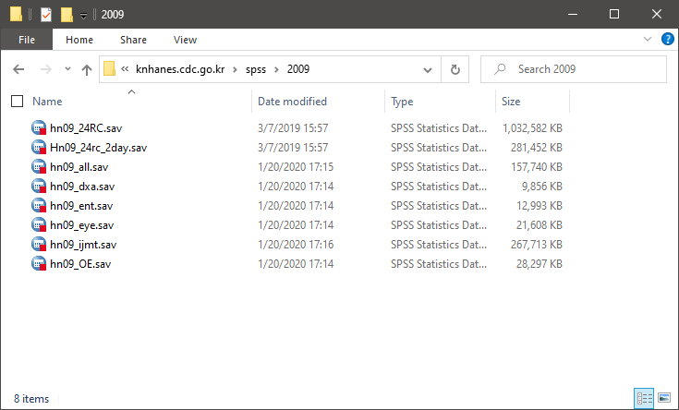
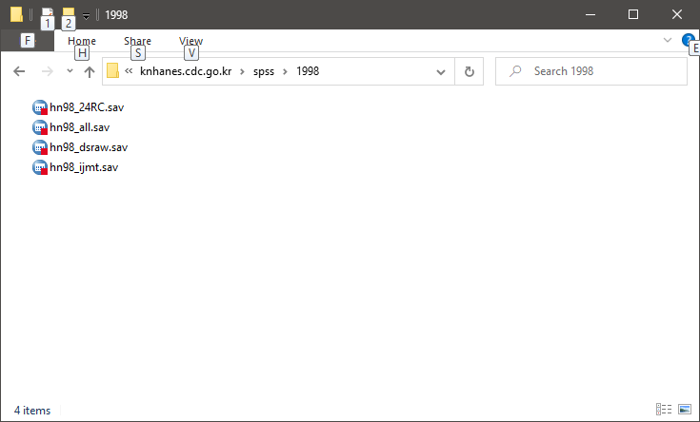
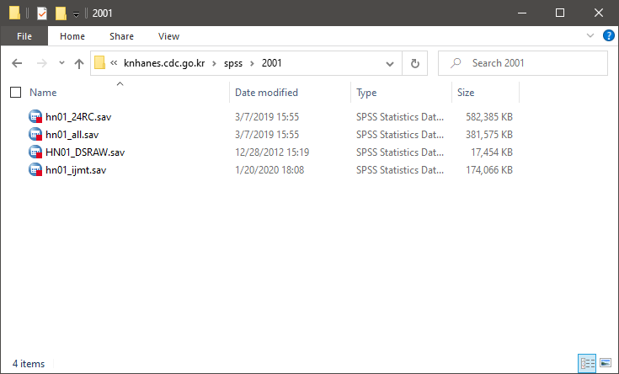
All DB merging
DXA
ENT
EYE
ALL
IJMT
DSRAW
ALL
IJMT
DSRAW
ALL
IJMT
DSRAW
Variable merging
Variable merging
Variable merging
1998
2001
2009
Case merging
1998 + 2001 + 2009

Slide 11
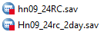
24RC merging
HN09_24RC
HN09_24RC_2day
Case merging
HN98_24RC
HN01_24RC
HN09_24RC
Case merging
24RC(1998 + 2001 + 2009)

Slide 12
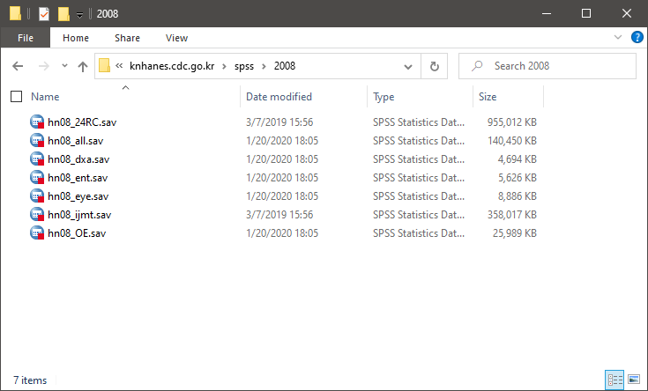


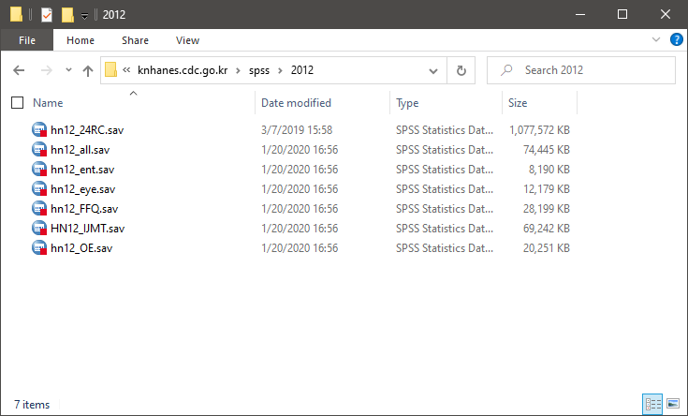
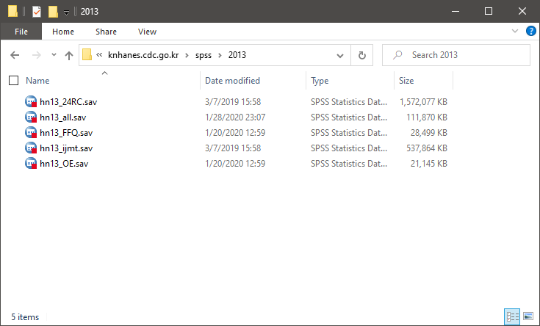


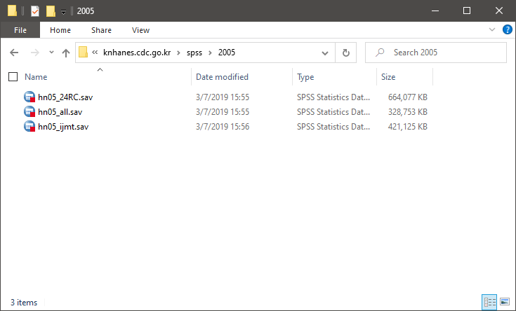
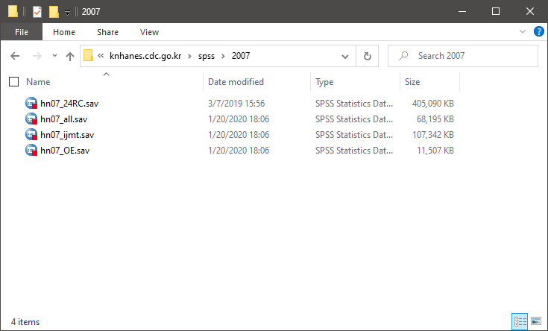
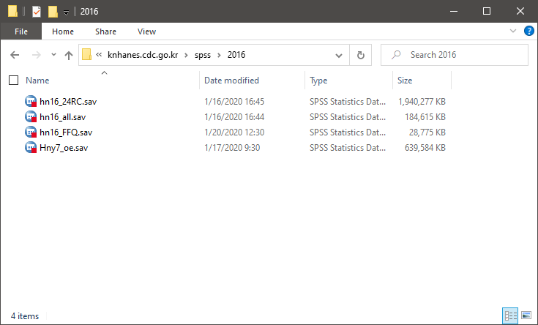
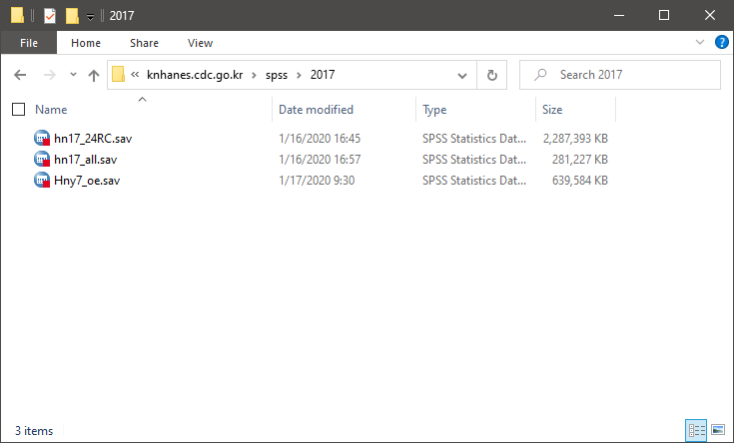

Merge overall
All DB
Variable merging
Variable merging
Variable merging
Variable merging
Variable merging
Variable merging
Variable merging
Variable merging
Variable merging
Variable merging
Variable merging
Variable merging
Variable merging
Variable merging
Variable merging
Case merging
24RC
Case merging
Case merging

Slide 13
References
[1] 질병관리본부, “국민건강영양조사 원시자료 이용지침서 제7기 1,2차년도(2016-2017)”, 2019. 01.
연도별 데이터 종류 Types of data by year: pp. 43-76
데이터 의미 해석 Interpret the data: pp. 79-292
[2] 질병관리본부, “국민건강영양조사 원시자료 분석 지침서(SPSS)”, 2013. 05.
[3] 통계청, “『국민건강영양조사』 통계정보 보고서”, 2015. 12.

